Slide 1
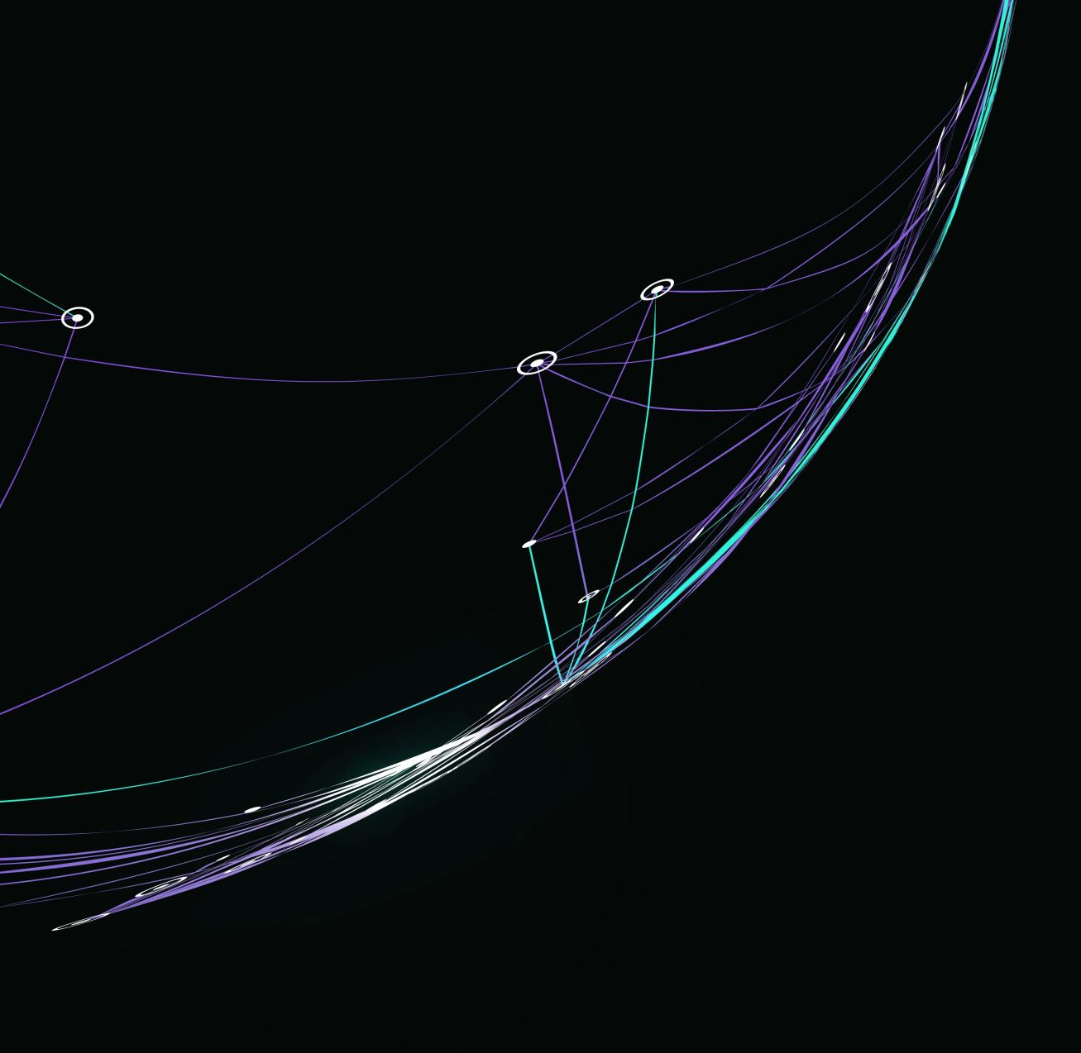
Psychological Measurement Week 2

Slide 2
Aims of the session
Session 1
Consider attribute profiles
Discuss scenarios in which profiles are used
Explore types of decision that can be made using profiles
Critique these decisions in terms of their consequences
Session 2
Reverse scoring
Distributions of scores
Exploring available assignment measures

Slide 3
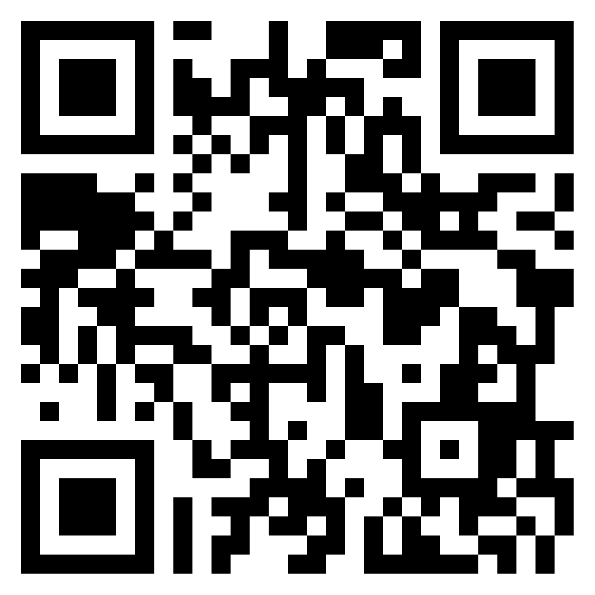
But First - Reflections
Something you’ve learned
Something you’ve enjoyed
Something you’ve found challenging
tinyurl.com/3k6yxs6y
Group 1

Slide 4
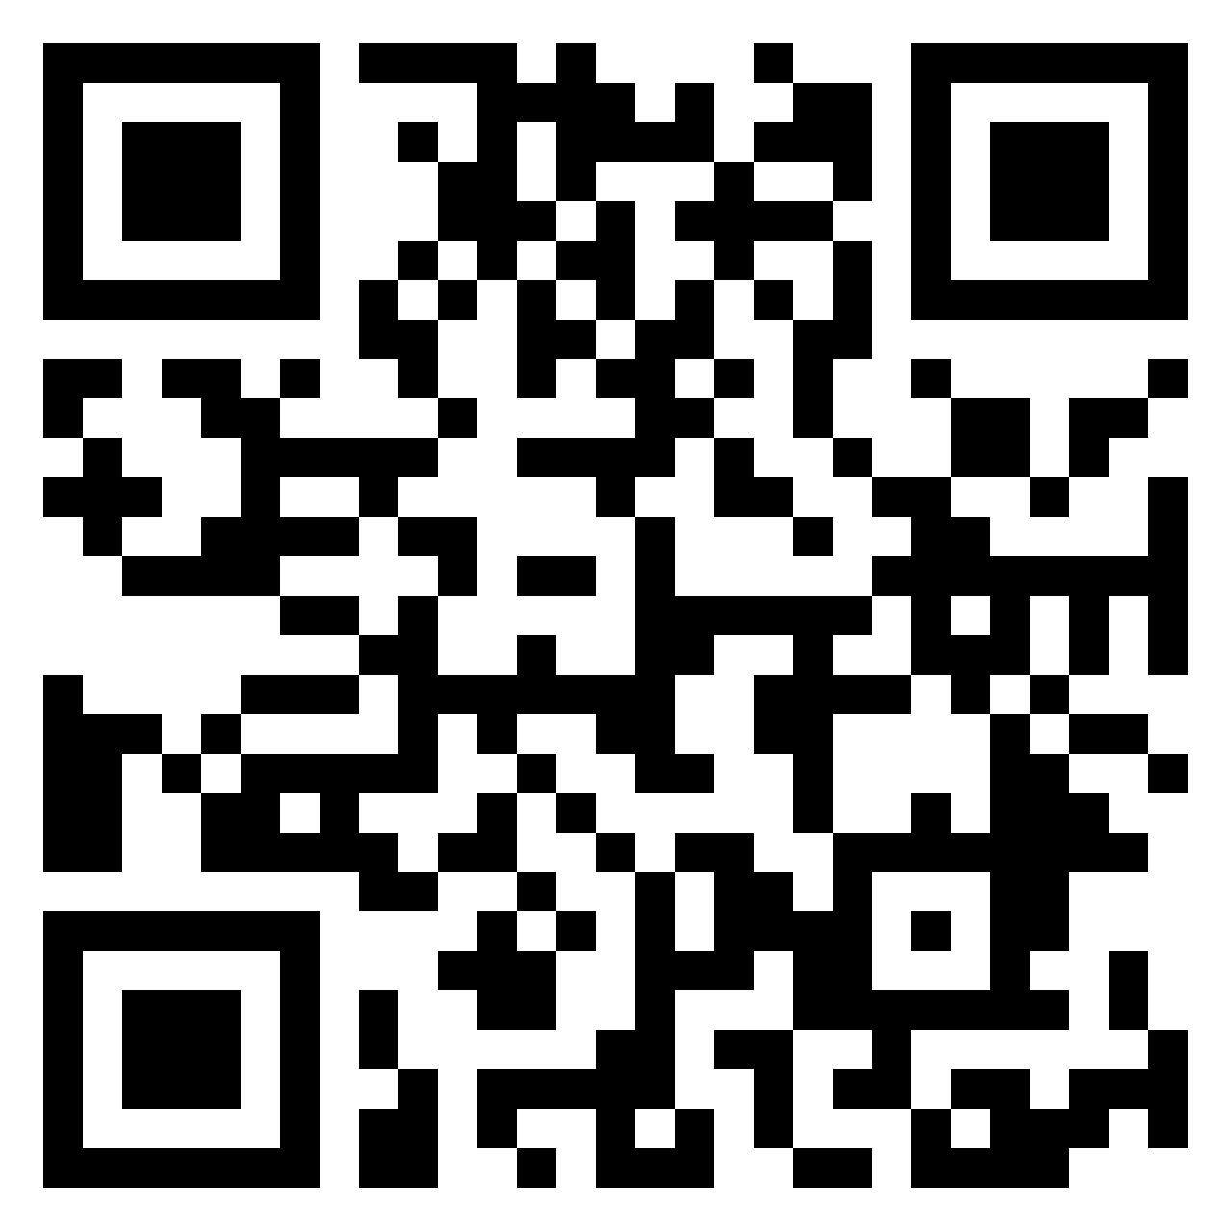
But First - Reflections
Something you’ve learned
Something you’ve enjoyed
Something you’ve found challenging
tinyurl.com/hjbynnnw
Group 2

Slide 5

Imaginary Scenario
“They were nice, but not my type”
You’re on the show blind date (or the Guardian column, or a friend has set you up…)
You go for dinner with someone you know little about
After the date you tell Cilla/ the reporter/ your friend…

Slide 6
Discuss
Reflect on the statement ‘nice but not my type’
What has happened here?

Slide 7
Nice but not my type….
Observed Behaviour
+ Nice to hospitality staff
- Talked too much about their job
Inference
+ Probably a nice person
- Probably doesn’t have a lot of interests
Comparison
+ Nice is something I’m looking for
- But I need someone who can hold a conversation (someone else would be better suited)
Judgement
+ Nice
- Not my type
Decision
Consequence
Not the person for me
No second date

Slide 8

Activity
Think of a scenario in which inferences and judgements are made on the basis of behaviour and fill in the gaps on the next slide
Doesn’t need a positive and a negative like before
Prepare to feedback to the group.

Slide 9
Observations, Inferences, Consequences
Observed Behaviour
Inference
Comparison
Judgement
Decision
Consequence

Slide 10

Feedback
What did you come up with?

Slide 11
Outcomes
Not your type
Your type
Disasterous mismatch
The one that got away – and you never realized!
Phew!
Wrong Choice
Happily ever after
Right choice
Wrong choice
Right Choice
False Positive
True Positive
Pursue
True Negative
False Negative
Don’t Pursue

Slide 12

Consequences of Decisions
In groups, think of ways in which decisions might have positive and negative consequences
How do you think we can minimise false positive and false negative decisions?
What sources of ‘error’ are there in these scenarios?

Slide 13
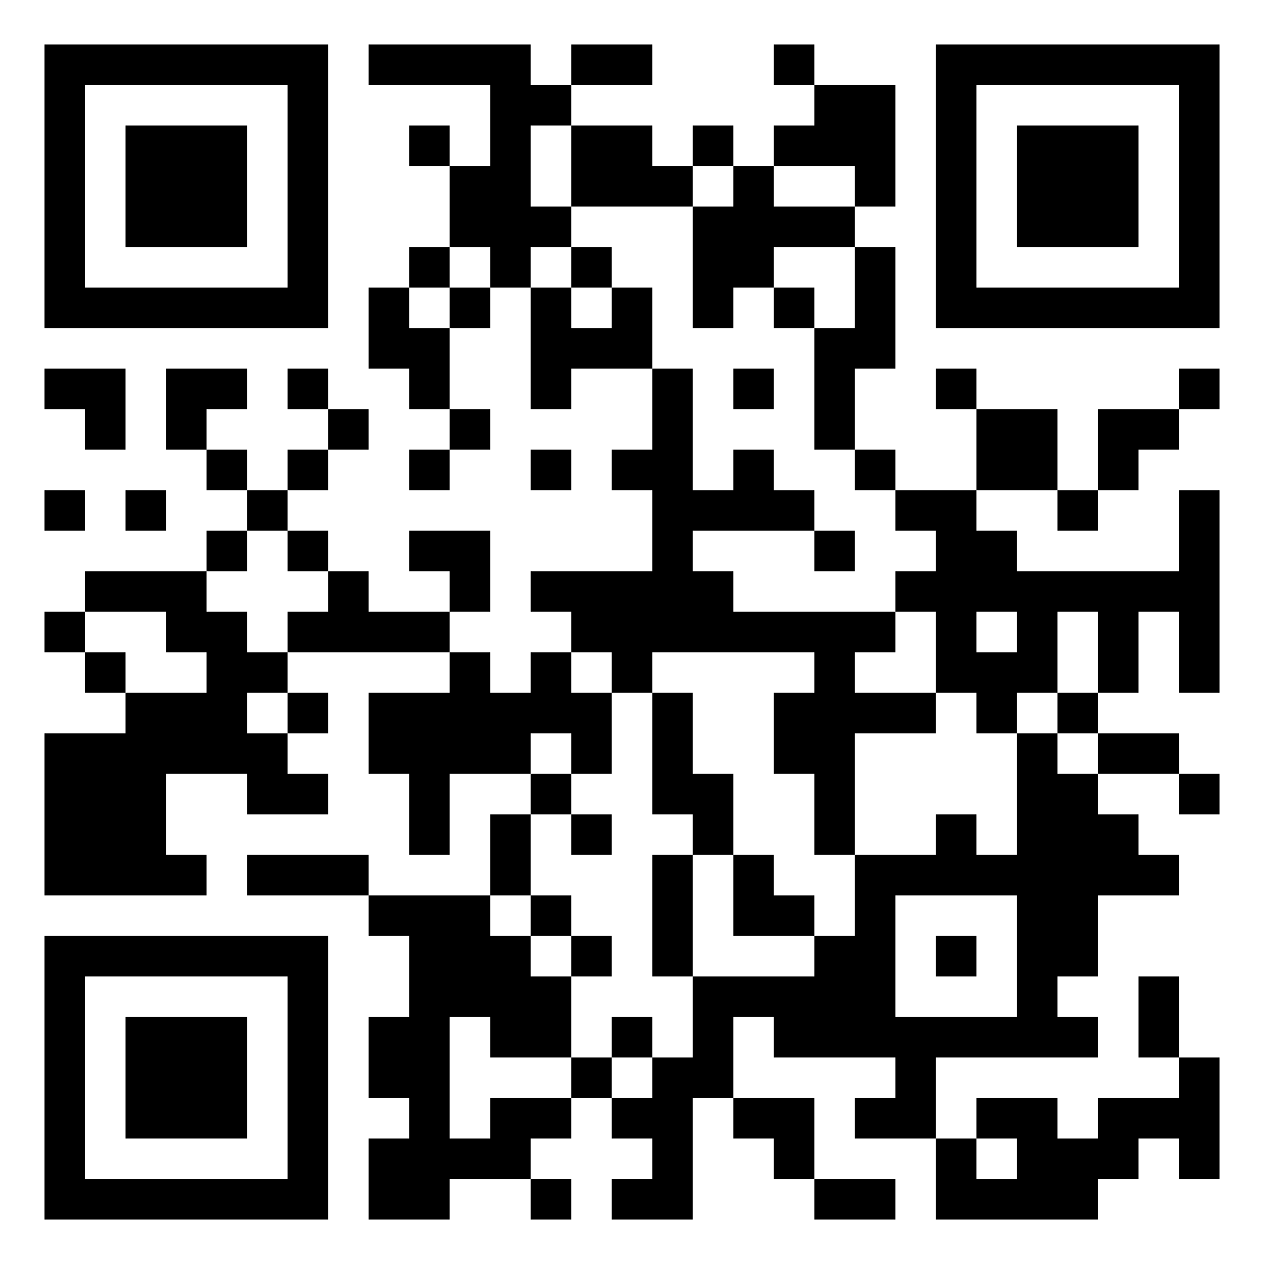
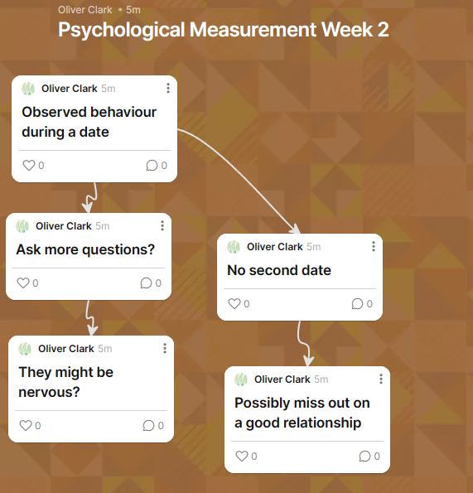
tinyurl.com/y4bd55un

Slide 14

Session 2

Slide 15
Structure
Brief Introduction to Percentiles
Fake Data Demo
Exploring assignment measures

Slide 16

Percentiles
Percentage of people who score above a particular score
Ordinal data type
NOT THE PERCENTAGE DIFFERENCE FROM THE NORM GROUP!

Slide 17
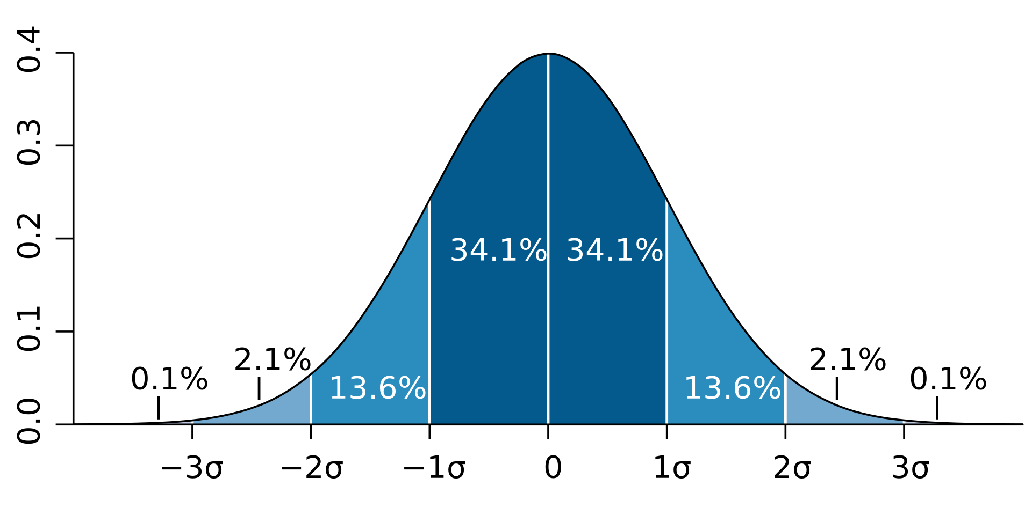
Percentiles
Higher than 2% of the group (lower than 98%)
Higher than 50% of the group
Higher than 99% of the group

Slide 18
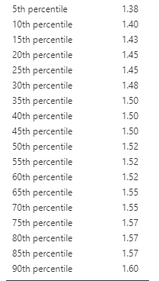
Percentiles

Slide 19
Assignment Measures
Sub-Factors | Scale
Narcissistic | NPI
Machiavellian Personlaity | MACHIV
Big 5 Personality | NEO-PI
Hypersensitive Narcissism & Dark Personality | HSN_DD
Dark Personality | SD3
Verbal Intelligence | VIQT
Right Wing Authoritarianism | RWAS

Slide 20
Worksheet
Select one measure
What is the construct?
Think of one use for the measure
What is the data type?
Open it in Jamovi
Means?
SD’s
Any group variables?

